Slide 1
2022 mcm Problem C
Trading Strategies
LIU Shenquan
SCUT-MATHEMATICS

Slide 2
Contents
1、Problems Background
Market traders buy and sell volatile assets
2、The Price Prediction Model
ARIMA:Autoregressive Integrated Moving Average model
LSTM :Long short-term memory
3、Trade strategy
Grid strategy and Martingale strategy
4、Investment Strategy
Multi-objective Linear Programming Model
Dynamic Programming-Genetic Algorithm
5、The best Trading Strategies Gold and Bitcoin
6、Conclusions-Flow Chart

Slide 3
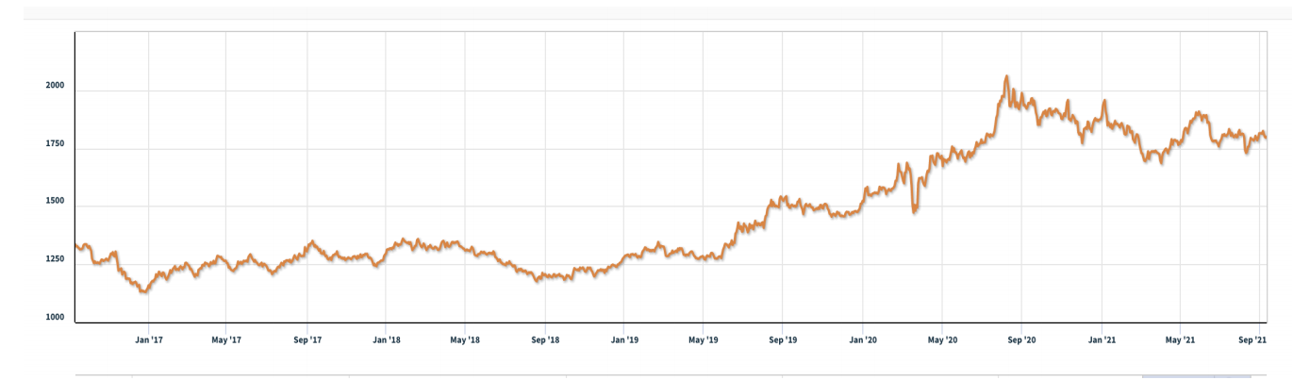
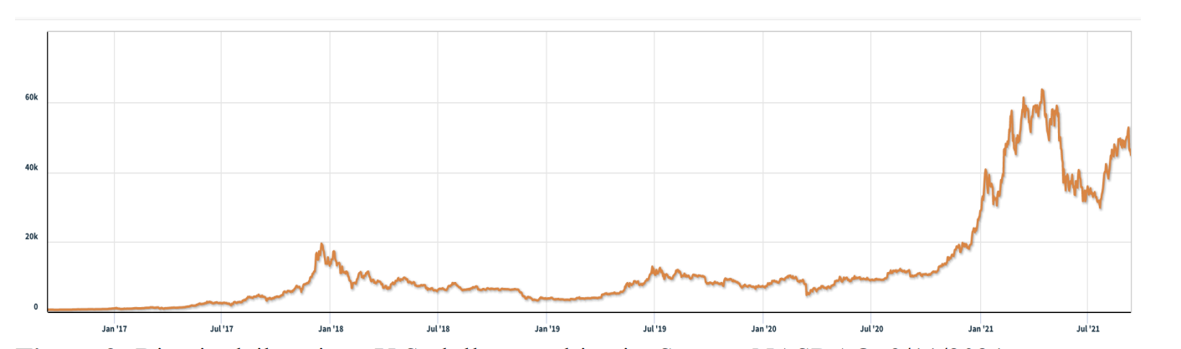
1、Problems Background
2022 MCM PROBLEM C: Trading Strategies
Background Market traders buy and sell volatile assets frequently, with a goal to maximize their total return.There is usually a commission for each purchase and sale. Two such assets are gold and bitcoin.
Figure 1: Gold daily prices, U.S. dollars per troy ounce. Source: London Bullion Market
Association, 9/11/2021
Figure 2: Bitcoin daily prices, U.S. dollars per bitcoin. Source: NASDAQ, 9/11/2021
Attachments
THE TWO DATA FILES PROVIDED CONTAIN THE ONLY DATA YOU SHOULD USE
FOR THIS PROBLEM. LBMA-GOLD.csv BCHAIN-MKPRU.csv
Data Descriptions
LBMA-GOLD.csv Date: The date in mm-dd-yyyy (month-day-year) format.
USD (PM): The closing price of a troy ounce of gold in U.S. dollars on the indicated
date.BCHAIN-MKPRU.csv
Date: The date in mm-dd-yyyy (month-day-year) format.
Value: The price in U.S. dollars of a single bitcoin on the indicated date.

Slide 4
2022 MCM PROBLEM C: Trading Strategies
Requirement
You have been asked by a trader to develop a model that uses only the past stream of daily prices to date to determine each day if the trader should buy, hold, or sell their assets in their portfolio. You will start with $1000 on 9/11/2016. You will use the five-year trading period, from 9/11/2016 to 9/10/2021. On each trading day, the trader will have a portfolio consisting of cash, gold, and bitcoin [C, G, B] in U.S. dollars, troy ounces, and bitcoins, respectively. The initial state is [1000, 0, 0]. The commission for each transaction (purchase or sale) costs α% of the mount traded. Assume α g o l d α_{gold}α gold = 1% and α b i t c o i n _{bitcoin}α
bitcoin = 2%. There is no cost to hold an asset.
Note that bitcoin can be traded every day, but gold is only traded on days the market is open, as reflected in the pricing data files LBMA-GOLD.csv and BCHAIN-MKPRU.csv. Your model hould account for this trading schedule. To develop your model, you may only use the data in the two spreadsheets provided: LBMA-GOLD.csv and BCHAIN-MKPRU.csv.
Develop a model that gives the best daily trading strategy based only on price data up to that day. How much is the initial $1000 investment worth on 9/10/2021 using your model and strategy? Present evidence that your model provides the best strategy. Determine how sensitive the strategy is to transaction costs. How do transaction costs affect the strategy and results? Communicate your strategy, model, and results to the trader in a memorandum of at most two pages. Your PDF solution of no more than 25 total pages should include: ne-page Summary Sheet. Table of Contents. Your complete solution. One- to two-page Memorandum. Reference List.
Note: The MCM has a 25-page limit. All aspects of your submission count toward the 25-page imit (Summary Sheet, Table of Contents, Reference List, and any Appendices). You must cite the sources for your ideas, images, and any other materials used in your report.

Slide 5
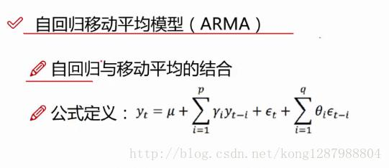
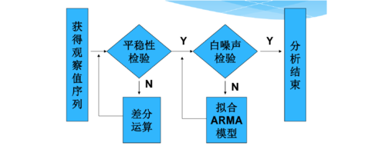
2、The Price Prediction Model time series forecasting model
ARIMA:Autoregressive Integrated Moving Average model
自回归(AR)模型；
移动平均(MA)模型；
自回归移动平均(ARMA)模型；
自回归整合移动平均模型(ARIMA)；
季节性整合自回归移动平均模型(SARIMA)模型。

Slide 6
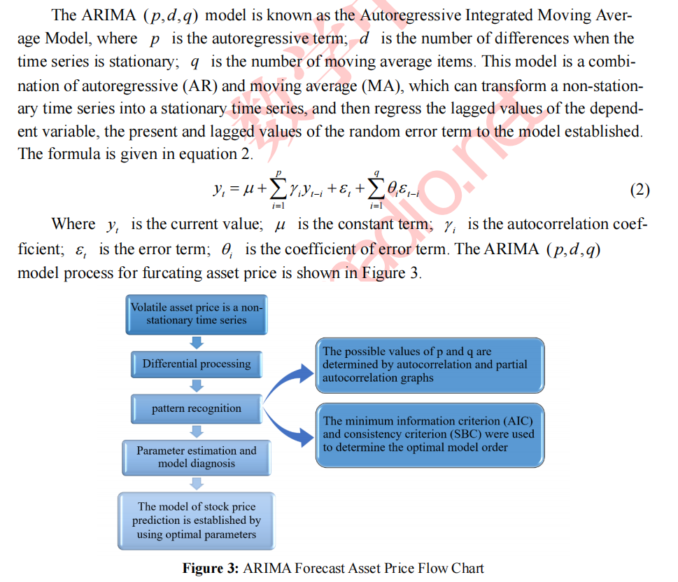
Forecasting - Linear Model
Autoregressive Integrated Moving Average

Slide 7
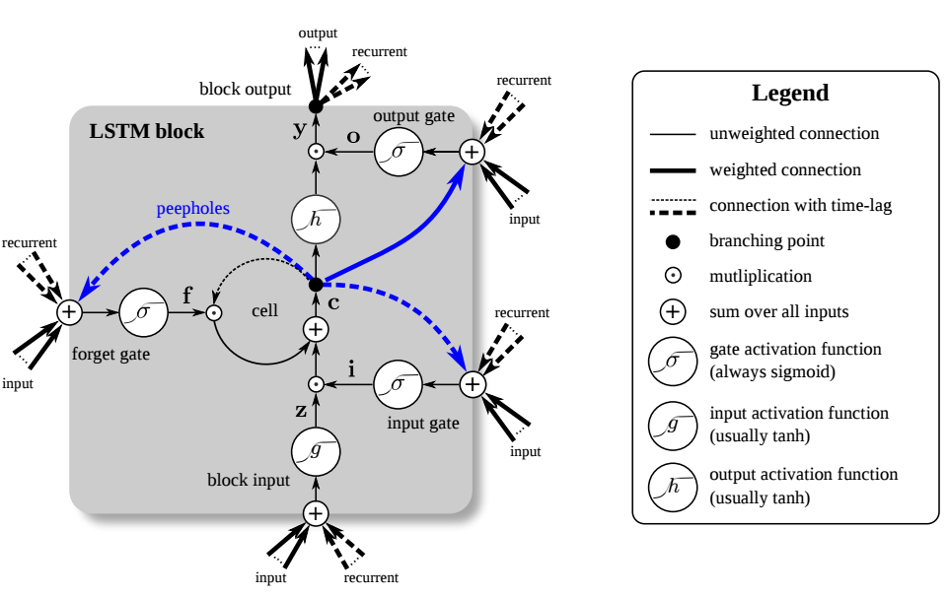
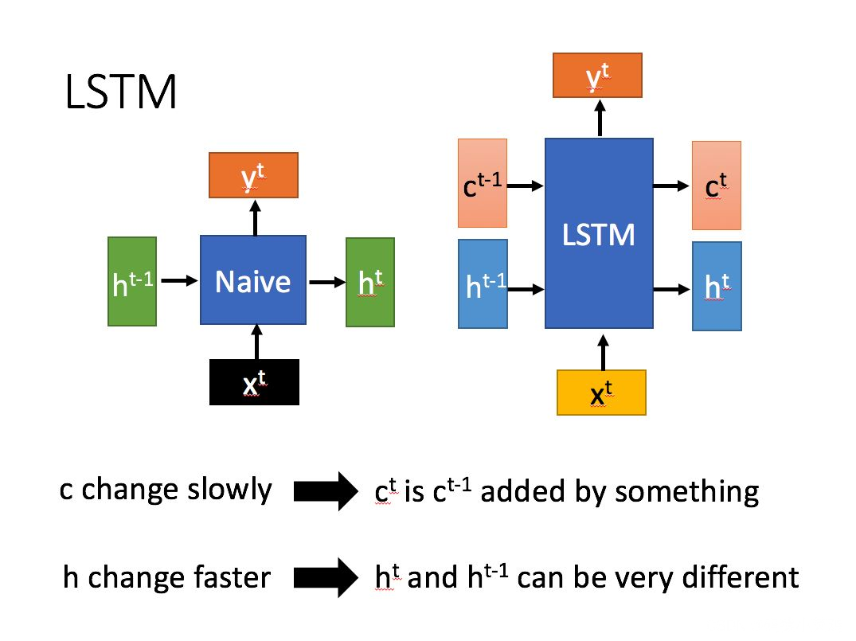
2、The Price Prediction Model time series forecasting model
LSTM :Long short-term memory
A Long short-term memory (LSTM) is a type of Recurrent Neural Network specially designed to prevent the neural network output for a given input from either decaying or exploding as it cycles through the feedback loops. The feedback loops are what allow recurrent networks to be better at pattern recognition than other neural networks. Memory of past input is critical for solving sequence learning tasks and Long short-term memory networks provide better performance compared to other RNN architectures by alleviating what is called the vanishing gradient problem.
LSTMs due to their ability to learn long term dependencies are applicable to a number of sequence learning problems including language modeling and translation, acoustic modeling of speech, speech synthesis,speech recognition, audio and video data analysis, handwriting recognition and generation, sequence prediction, and protein secondary structure prediction.

Slide 8
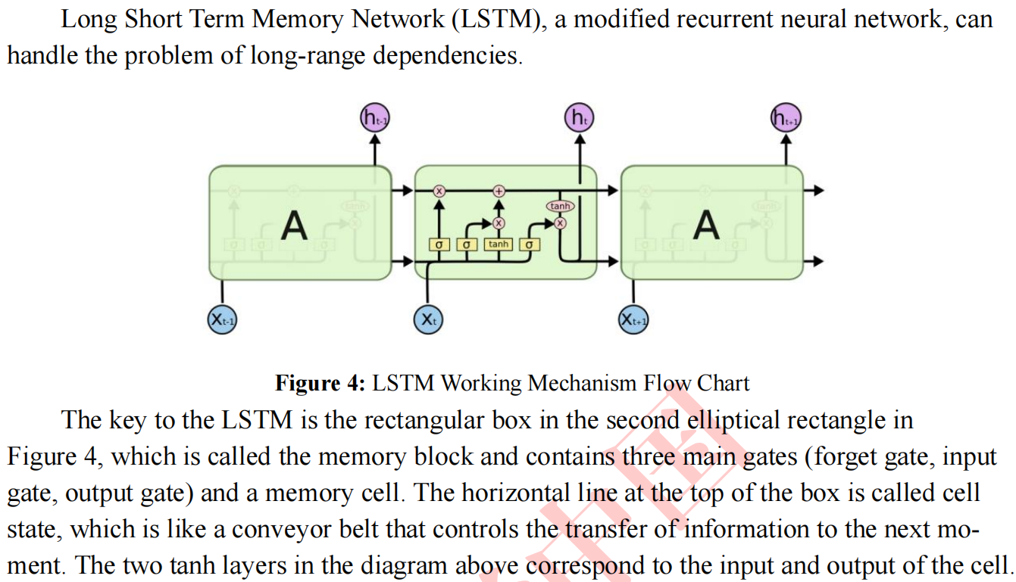
Forecasting - NonLinear Model
LSTM Neural Network Nonlinear Prediction Model

Slide 9
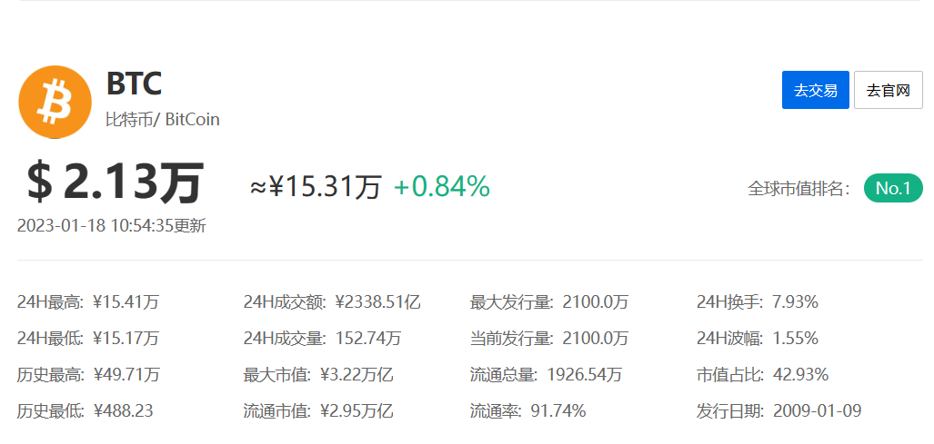
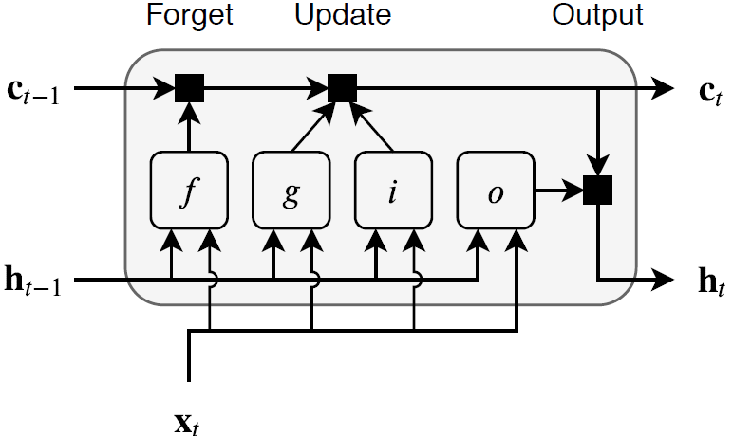
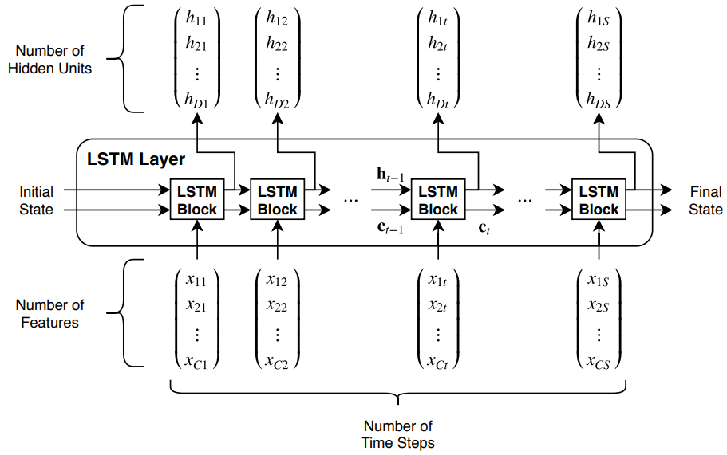
LSTM 网络
C个长度为S的特征的时序X通过LSTM层的流程。
ht和ct分别表示在时间步t的输出和单元状态。
金融时间序列预测

Slide 10
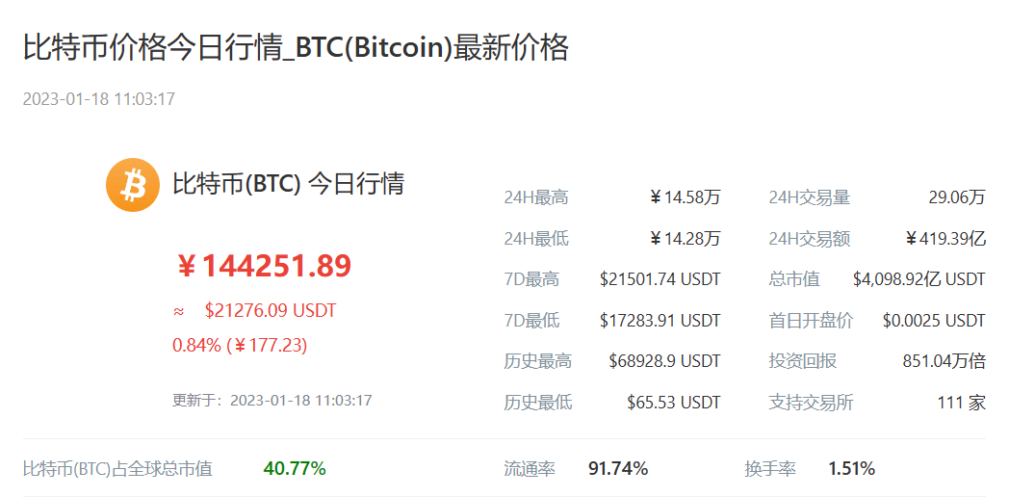
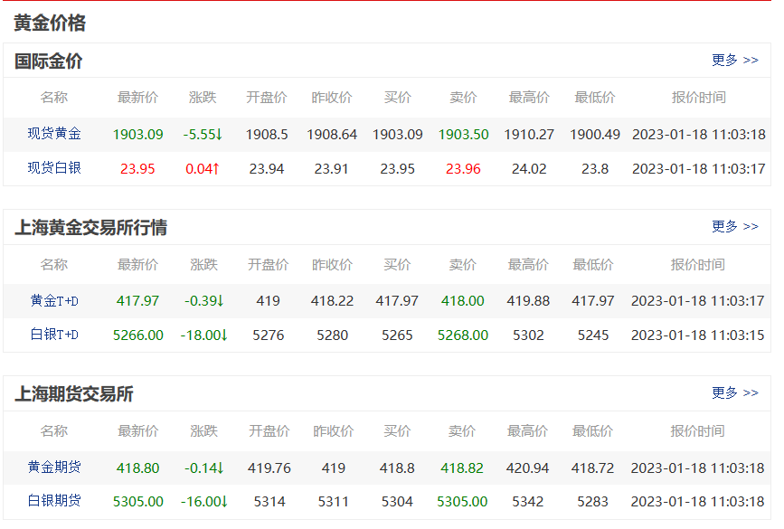
基于Bitcoin and gold 特征指标的LSTM
Bitcoin and gold 特征指标-输入
Bitcoin and gold 特征指标-输出
今开：最高：最低：昨收：振幅：
学习时间：天（高频交易）

Slide 11
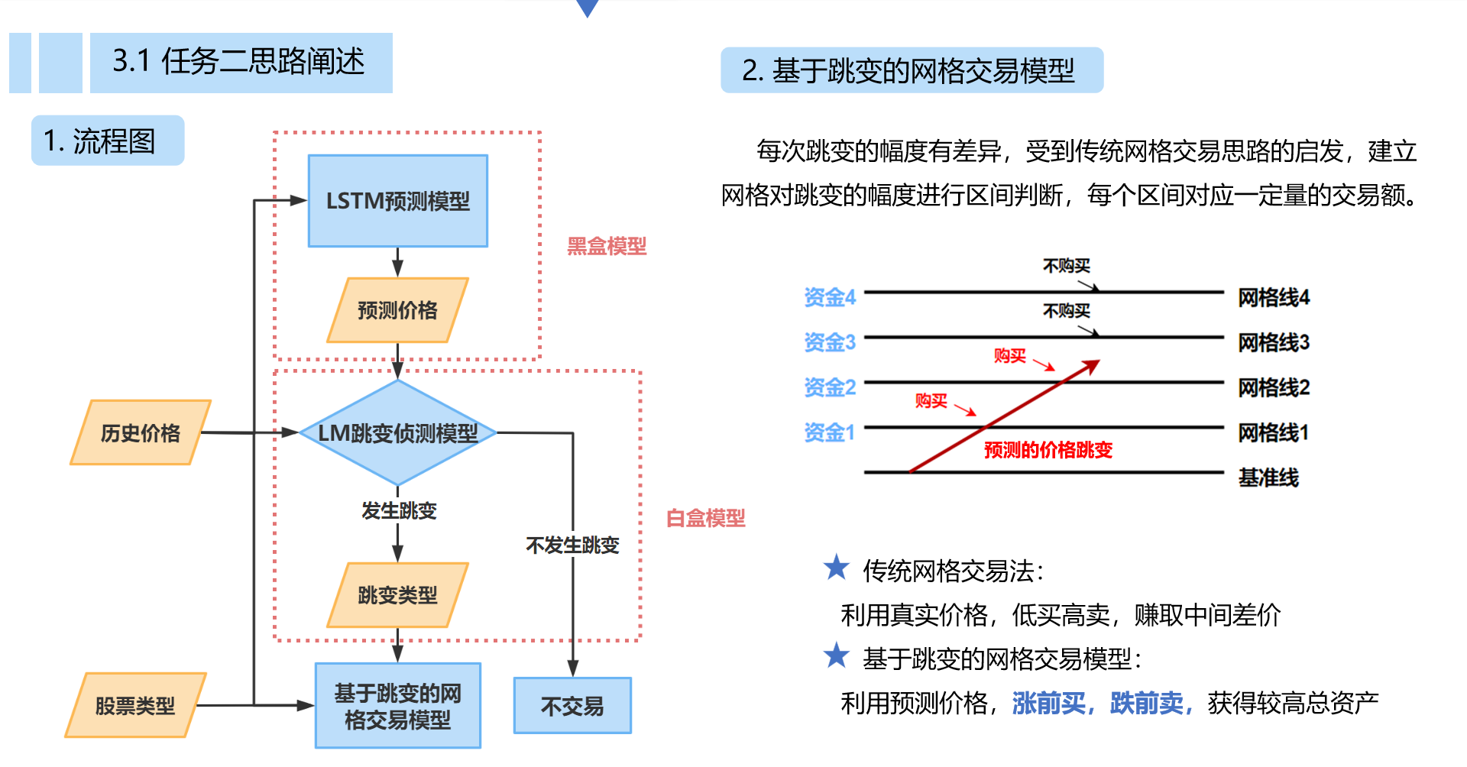
3、Trade strategy
Grid strategy and Martingale strategy

Slide 12
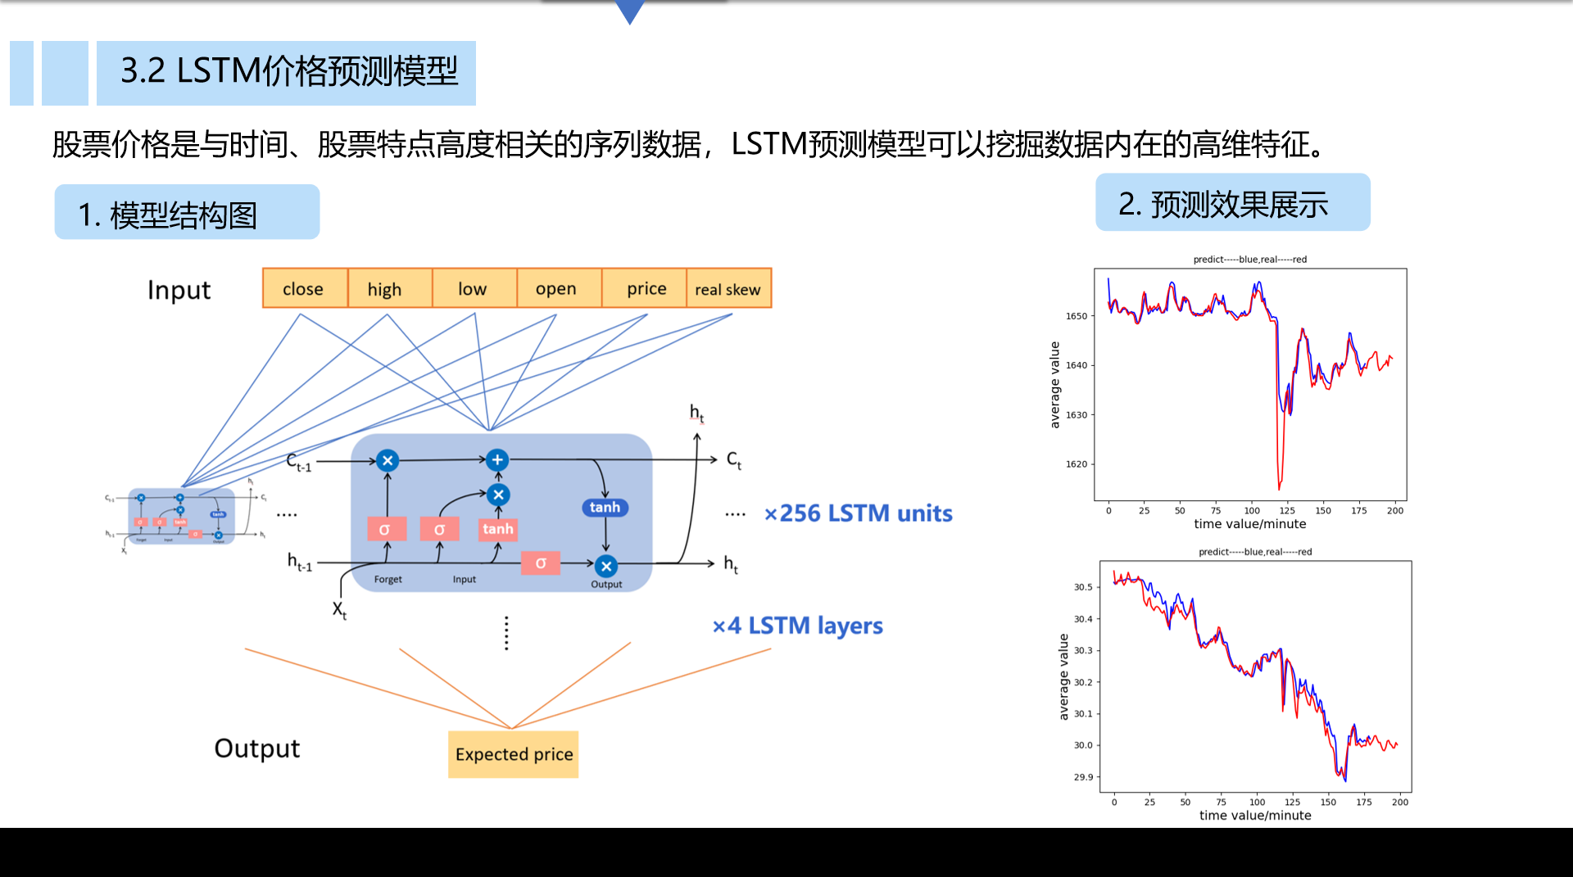
Trade strategy
LSTM Forecasting-Grid Strategy

Slide 13
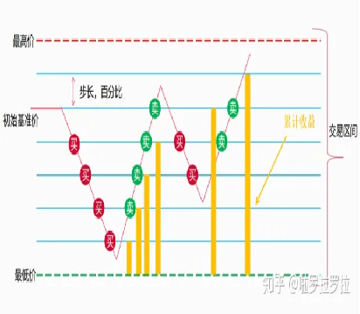
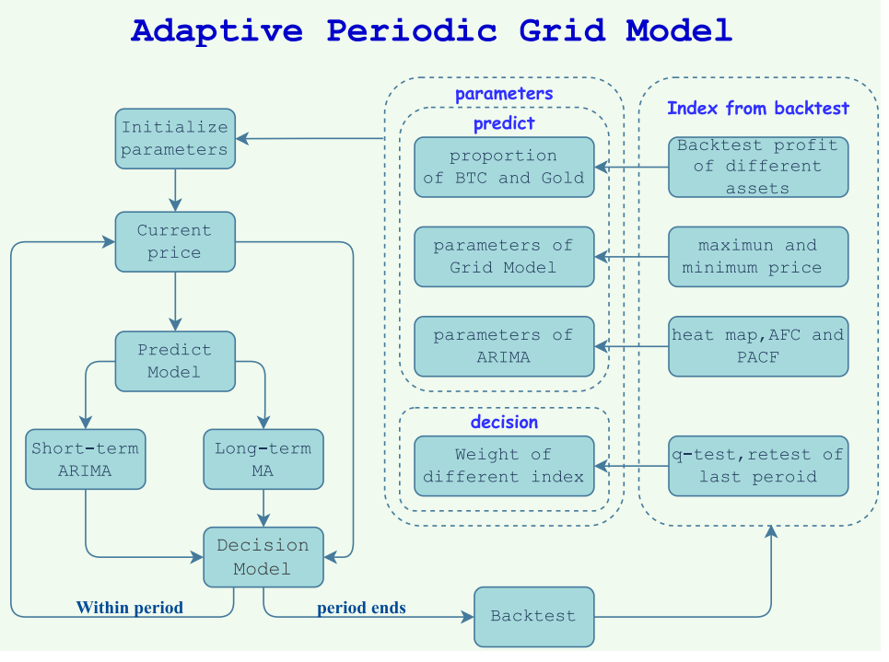
Forecasting Model
LSTM Forecasting-Grid Strategy
Trade strategy
LSTM Forecasting-Grid Strategy

Slide 14
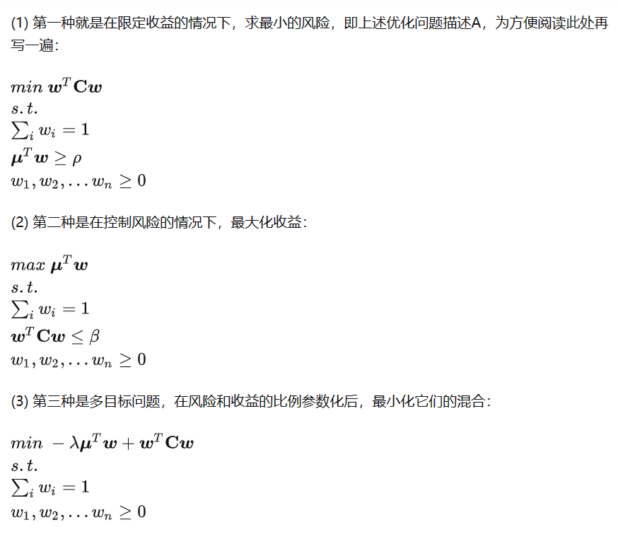
Trading Strategy
Portfolio Theory
Investment strategy model (Multi-objective Linear Programming)
交易策略
马科维茨投资组合模型

Slide 15
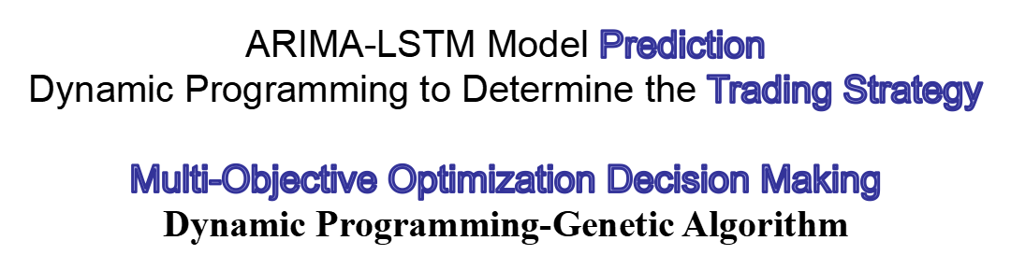
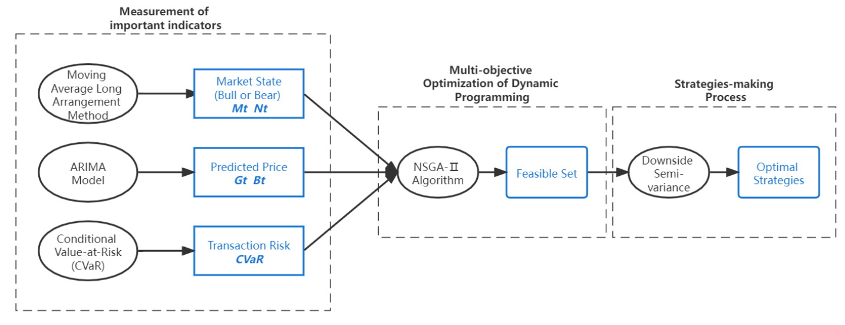

Slide 16
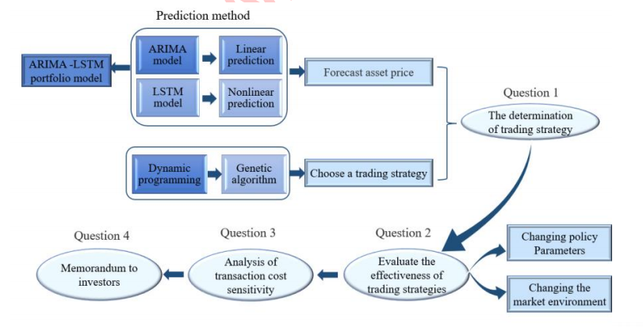
6、Conclusions-Flow Chart

Slide 17
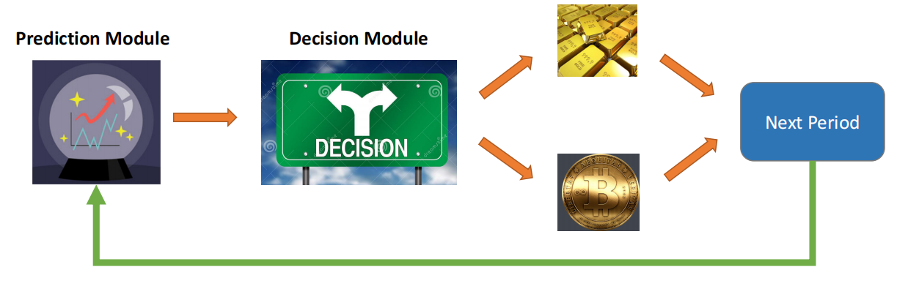
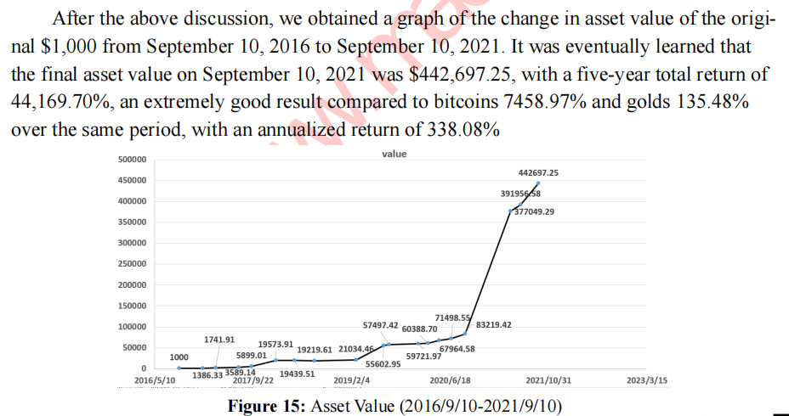
Asset Value Estimation

Slide 18
Market traders buy and sell volatile assets
(1)The Price Prediction Model
ARIMA:Autoregressive Integrated Moving Average model
LSTM :Long short-term memory
(2)Trade strategy
Grid strategy and Martingale strategy
(3)Investment Strategy
Multi-objective Linear Programming Model
Dynamic Programming-Genetic Algorithm
(4)The Best Trading Strategies Gold and Bitcoin
多谢！

